Slide 1
Email Security
SS19CO018 - Tejas Jadhav

Slide 2
Electronic Mail
Electronic mail - commonly referred as email - is a method of exchanging messages between people using electronic devices.
Electronic approach to traditional mails (letters)
Fast
Cheap
Anytime
Anywhere

Slide 3
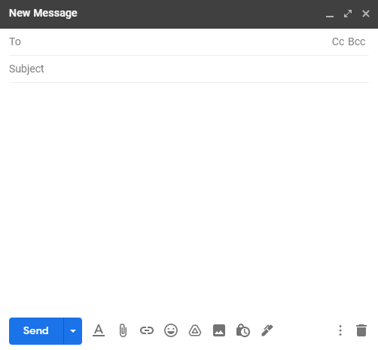
Notes:
Cc - send a carbon copy to someone apart from recipients
Bcc - same as cc but you can’t see other recipients
Maximum size of email is server based for eg. google - 25mb

Slide 4
Email Address
Unique Identifier to an email account
Where to deliver the email
john.smith43@gmail.com
Username
(max length 64 alphanumeric)
Domain name
Top Level Domain
Over 4 billion unique emails as of the end of 2020 (50% of the world’s population)

Slide 5
Simple Mail Transfer Protocol
SMTP is an internet standard communication protocol for electronic mail transmission.
It is an application layer protocol
Transmission using TCP
The traditional port used for SMTP is TCP port 25 although TCP port 465 and TCP port 587 are also used.
SMTP is used only for sending email to the recipient server. IMAP or POP is used to retrieve mail.
Notes:
TCP UDP for transport layer

Slide 6
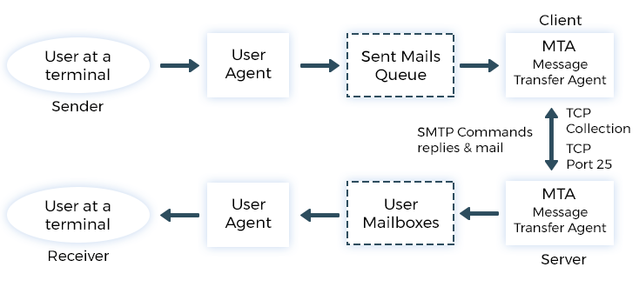
Working Principle of SMTP
Routing to appropriate server
smtp.gmail.com
gmail.com
IMAP or POP

Slide 7
SMTP Commands (Client)
Command | Function
EHLO | Initiate New Session
MAIL FROM <email> | Initiate Sending of new email and Identify Sender
RCPT <emails> | Identify Recipients
DATA | Indicates start of email
. | Indicate the end of email
QUIT | Terminate the session

Slide 8
SMTP Responses (Server)
211 → System status
214 → Help
220 → Service Ready
221 → Service Close
250 → Ok
421 → Service NA
450 → Mailbox NA
451 → Command aborted
500 → Syntax Error
554 → Transaction Failed

Slide 9
Email Client
Email Server
220 -Ready
ELHO
250 OK
MAIL FROM <abc@gmail.com>
250 OK
RCPT <xyz@gmail.com>
250 OK
DATA
QUIT
221 -Close

Slide 10
SMTP Advantages
SMTP offers reliability in terms of the outgoing email messages.
It is the simplest form of communication between various computers in a network via Email.
In those cases where a particular message was not delivered successfully then, the SMTP server always tries to re-send the same message until the transmission becomes successful

Slide 11
SMTP Disadvantages
SMTP does not provide good security.
It is only limited to 7-bit ASCII characters.
Beyond some specific length, email messages are rejected by SMTP servers

Slide 12
SMTP Security Issues
SMTP was launched on 1981
SMTP was designed in an era where internet security was not much of an issue; as a result, the base protocol includes no security mechanism at all.
SMTP Threats
Spam, phishing, MitM, malware, viruses, DoS, etc.
According to Verizon report (2019), 9 out of 10 malware attacks occur through emails via SMTP
Notes:
Easy to spoof email

Slide 13
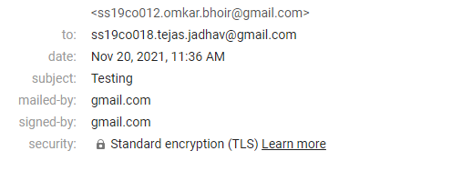
Email Security Standards
SSL/TLS
End-to-end Encryption

Slide 14
SSL/TLS
These are security layers added before and after the email is sent via SMTP
SSL (Secure Socket Layer) has been deprecated in 2015 after the launch of TLS (Transport Layer Security) v1.3
The name “SSL” and “TLS” are often used interchangeably or together but it refers only to TLS

Slide 15
TLS
Handshake : Digital Signature, Shared key generation
Transmission : Email is encrypted using the Shared key and sent using SMTP
TLS security standard is given by the email service provider. Not all email service providers provide TLS.
TLS approach is either Opportunistic TLS or Forced TLS

Slide 16

Opportunistic TLS Forced TLS
During Handshake, asks if TLS is available
If TLS is available then the email will be sent using TLS encryption
If TLS is not available then the email will be sent through simple SMTP without any encryption
Ensures maximum deliverability for cost of occasional privacy
During Handshake, demands for TLS encryption
If TLS is available then the email will be sent using TLS encryption
If TLS is not available then the Transmission will terminate
Ensures maximum privacy at the cost of deliverability

Slide 17
End-to-end encryption
SSL/TLS encrypts the email at sender’s client and decrypts the email at receiver’s server. The email without any encryption then gets retrieved by receiver’s inbox. Also from sender’s device to the sender’s client, the email is not encrypted
A message is encrypted on a sender’s device before it’s even sent from a client. When it arrives at the recipient’s device, it’s decrypted by the recipient.
Uses Asymmetric key Cryptography
S/MIME and PGP are some of the most popular email security standard protocol

Slide 19
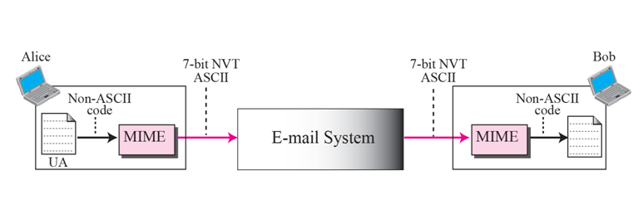
Multipurpose Internet Mail Extension (MIME)
Used to extend the capabilities of SMTP
SMTP only supports 7-bit ASCII values for data transfer
MIME converts Non ASCII data into 7-bit NVT ASCII values and vice versa

Slide 20
Benefits of MIME
MIME Headers
It supports multiple attachments in a single e-mail
It supports the non-ASCII characters
MIME Version
Content Type
Content Type encoding
Content ID
Content Description
These fields are added to the header portion of actual email

Slide 21
S/MIME
Secure / Multipurpose Internet Mail Extension
Used for sending signed and encrypted msgs
Asymmetric Cryptography
Achieve Authentication, Non-repudiation, confidentiality, integrity and Data security
Working is dependent on S/MIME Certificate
Can be easily added to popular email clients like Google, Outlook, etc.

Slide 22
S/MIME Certificate
“The Catch”
Key or Digital ID
Allows authentication of your emails
Encrypts and decrypts your email
Protects your emails/documents from modification
Both Sender and Receiver need to have S/MIME certificates
Need to send a message for the first time to exchange keys
S/MIME certificate are not permanent
They need to be bought after certain time

Slide 23
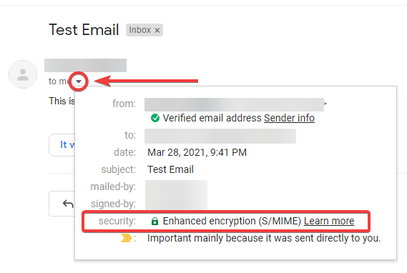

Slide 24
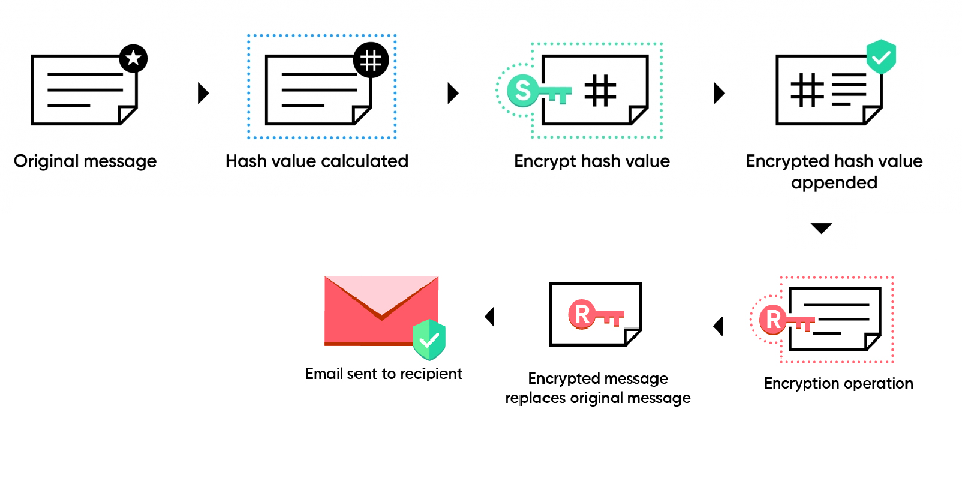
S/MIME Working (Encryption)

Slide 25
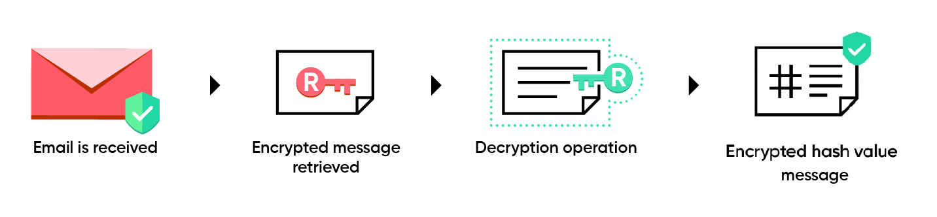
Decryption

Slide 26
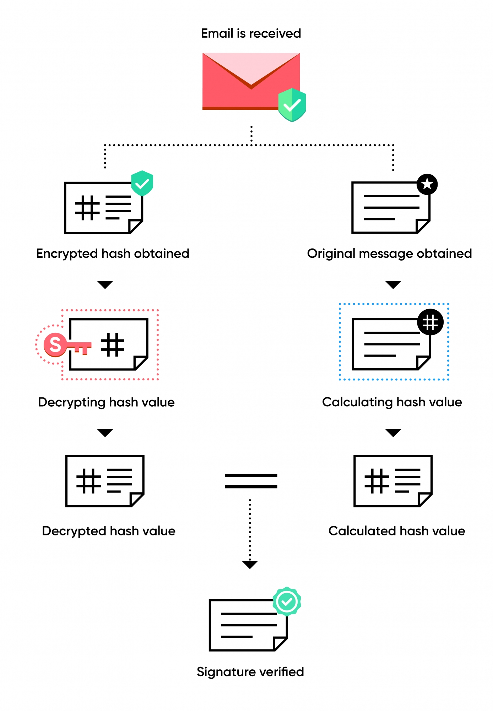
Signature Verification

Slide 27
PGP
Pretty Good Privacy
It’s not only used to encrypt emails but also files, directories, and entire disk partitions. Email-wise, the way it works is no different than S/MIME.
Achieve Authentication, Non-repudiation, confidentiality, integrity and data security
Uses combination of hashing, data compression, symmetric cryptography and asymmetric cryptography to encrypt data
Based on OpenPGP

Slide 28
PGP Encryption
Receiver’s Public key
Email
Shared Key
Encrypt
Sign
hash
+
ZIP
Encrypt
+
Email
Encrypt
Sign
Sender’s Private key
Digital Signature
Confidentiality

Slide 29
PGP Encryption
Receiver’s Public key
Email
Shared Key
Encrypt
Sign
hash
+
ZIP
Encrypt
+
Email
Encrypt
Sign
Sender’s Private key
Digital Signature
Confidentiality

Slide 30
PGP Decryption
Signature Verification
Receiver’s Private key
Sender’s Public key
Decrypt
Shared Key
Decrypt
Sign
Decrypt
Unzip
Compare
Email
hash
Email

Slide 31
Thank You !!!
References :
SMTP Security: Best Practices and Top Issues | Mailtrap Blog
Simple Mail Transfer Protocol - Wikipedia
Email - Wikipedia
What are the rules for email address syntax? – Validity Help Center (returnpath.com)
PGP - Authentication and Confidentiality - GeeksforGeeks
Gmail (google.com)
S/MIME - Encryption and other security extensions for email (zoho.com)

